Slide 1
Pet Clinic Analysis
Notes:
Analize girmeden önce bir tane intro sayfası ve akış eklenebilir.

Slide 2
Facts About Pets
Crocodiles may have the shortest lifespan and can live up to 11 years
Fish and cattle may not fall ill much until half of their life
Birds may require a lot of care in their first years of life
Older birds like parrots and albatrosses are unlikely to be brought to this clinic as they can live 30-60 years
Notes:
Executive summary sayfası eklenebilir.

Slide 3
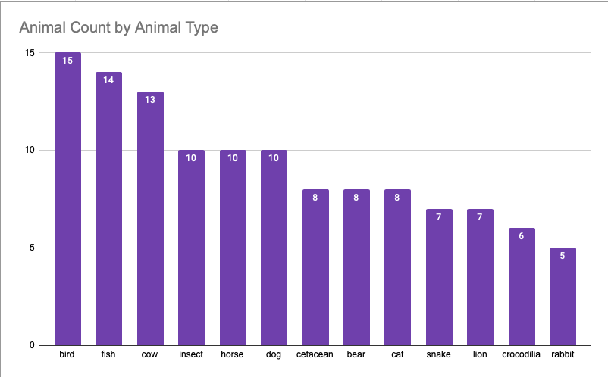
This clinic may primarily provide services to individuals who engage in commercial animal sales but also caters to pet owners

Slide 4
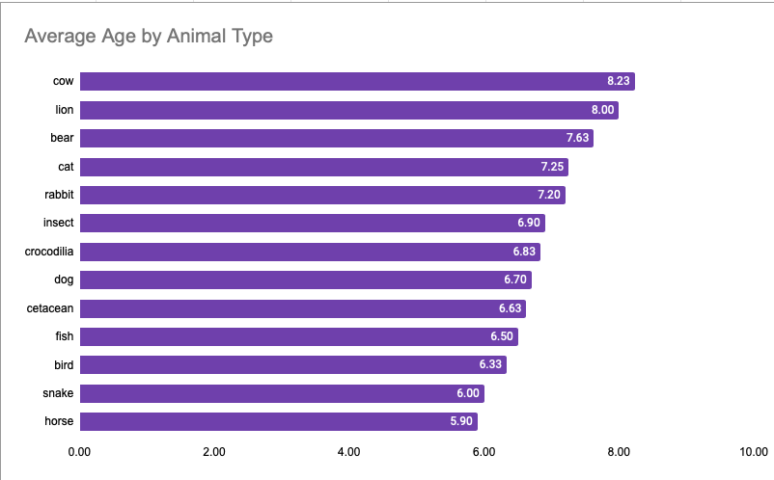
The average age of cattle that come to the clinic is 8.23 years, 2 years older than the average age of animals that come to the clinic
Notes:
Tüm hayvanların average lifespan’ine bakılıp bir yorum çıkarılabilir, örneğin klinik genç atlara bakım verme konusunda özelleşmiştir gibi. Fakat hayvanların cinsi belirtilmediği için ortalama yaşam süresi değişebilir.

Slide 5
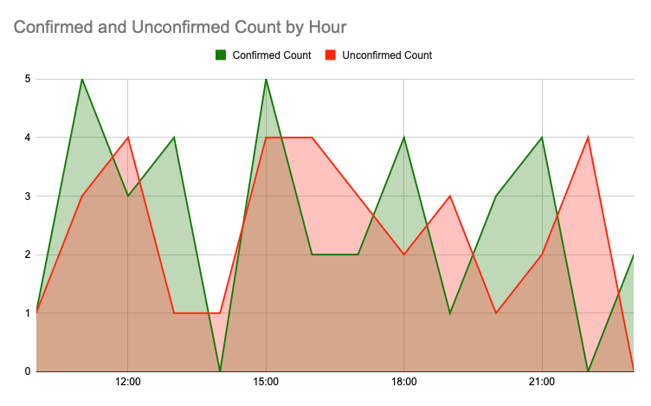
The pet clinic is open 24/7. On Friday, November 19th, 2021, clinic staff may be changing shifts at 2 PM and 10 PM as no appointments are accepted during those times

Slide 6
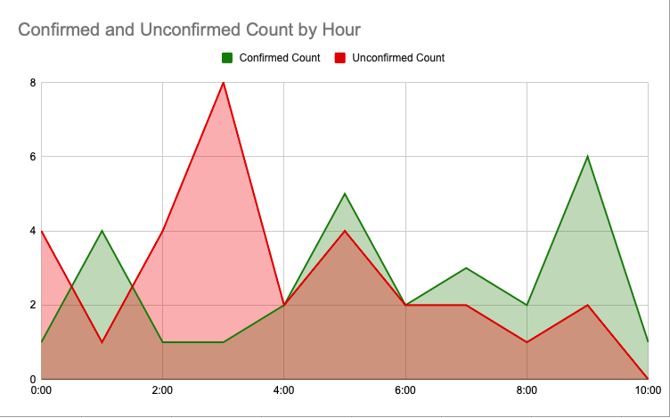
The clinic may not have enough staff working on Saturdays, particularly in the afternoon, due to high demand that may not be able to be met
Notes:
Klinik çalışan sayısını optimize etmeli, müşteri tahminlemesi modellerini kullanabilirler

Slide 7
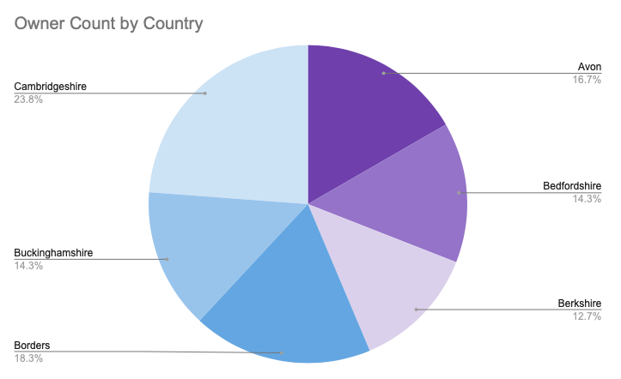
The clinic is located in a central location that is equidistant from all the cities where people bring their animals

Slide 8
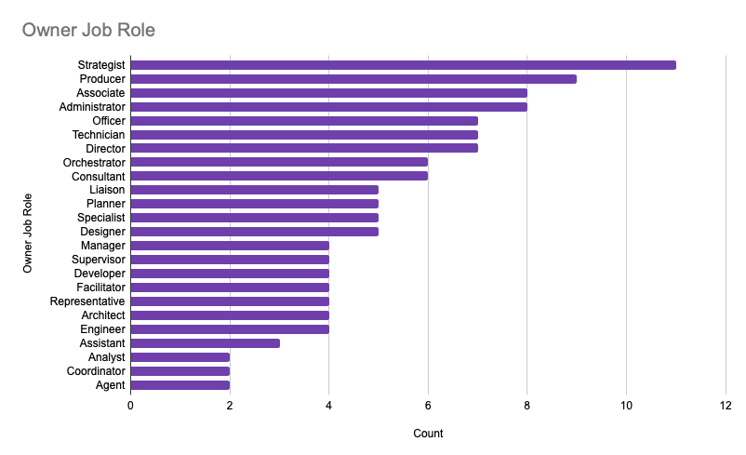
The presence of people who bring their animals to the clinic and have job roles as strategists may indicate that individuals in this profession tend to earn high salaries
Notes:
3rd party datayla zenginleştirilebilir örneğin glassdoor sitesinden strategist maaşlarına bakılabilir.

Slide 9
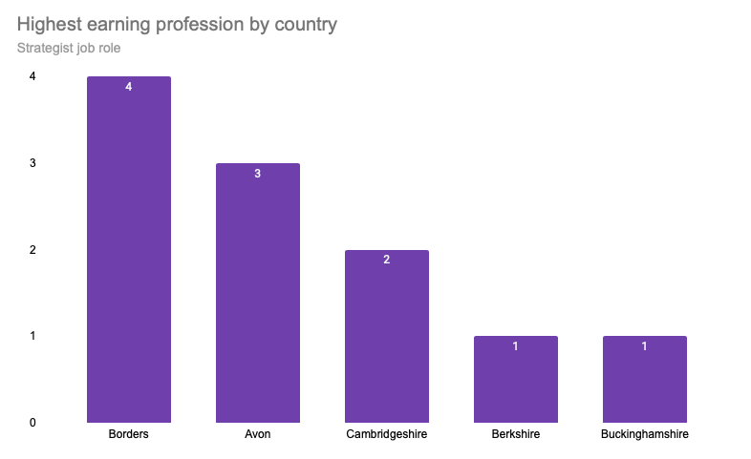
Strategists may be the highest earning profession among all, with the highest paying “Strategy” jobs in Borders country, while the lowest earning job is “Agency” and the lowest salary may be in Buckinghamshire country

